Slide 1
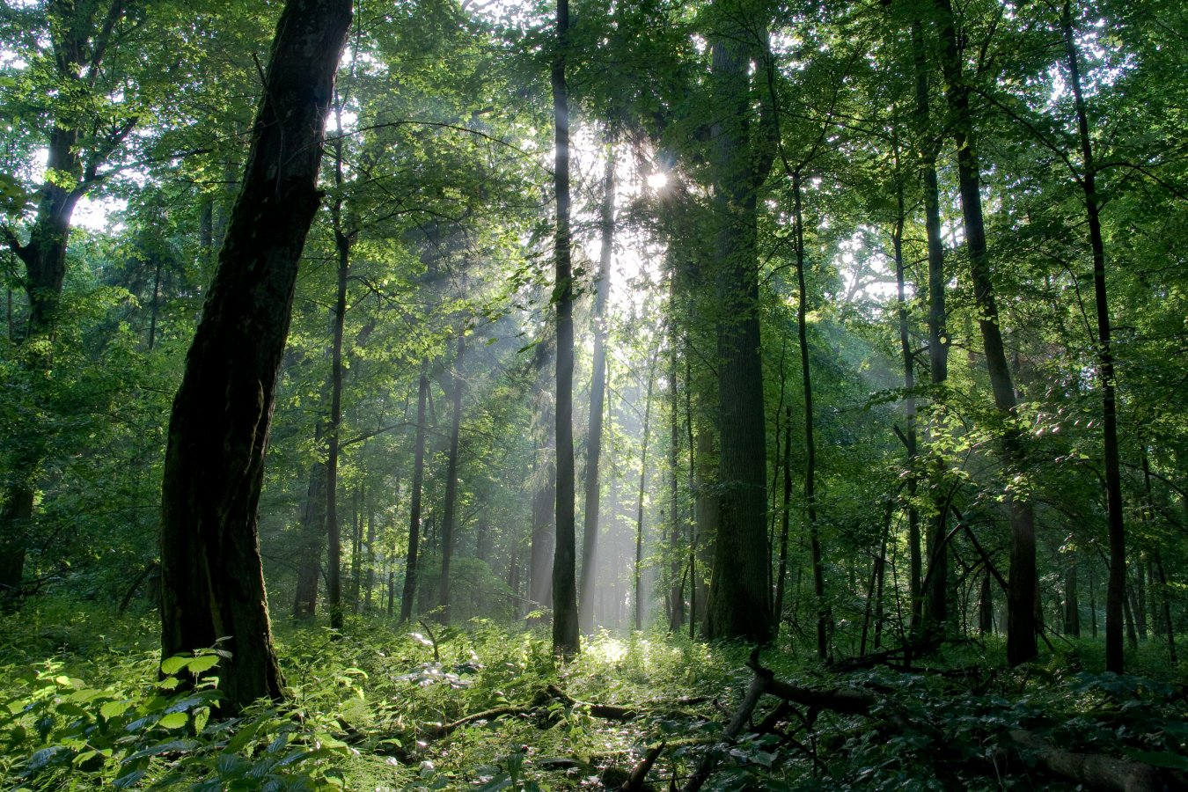
The Forest
1st Grade

Slide 2
Purpose
Find three animals in the forest that use whiskers/antennae.
How do these animals use their whiskers and antennae?

Slide 3
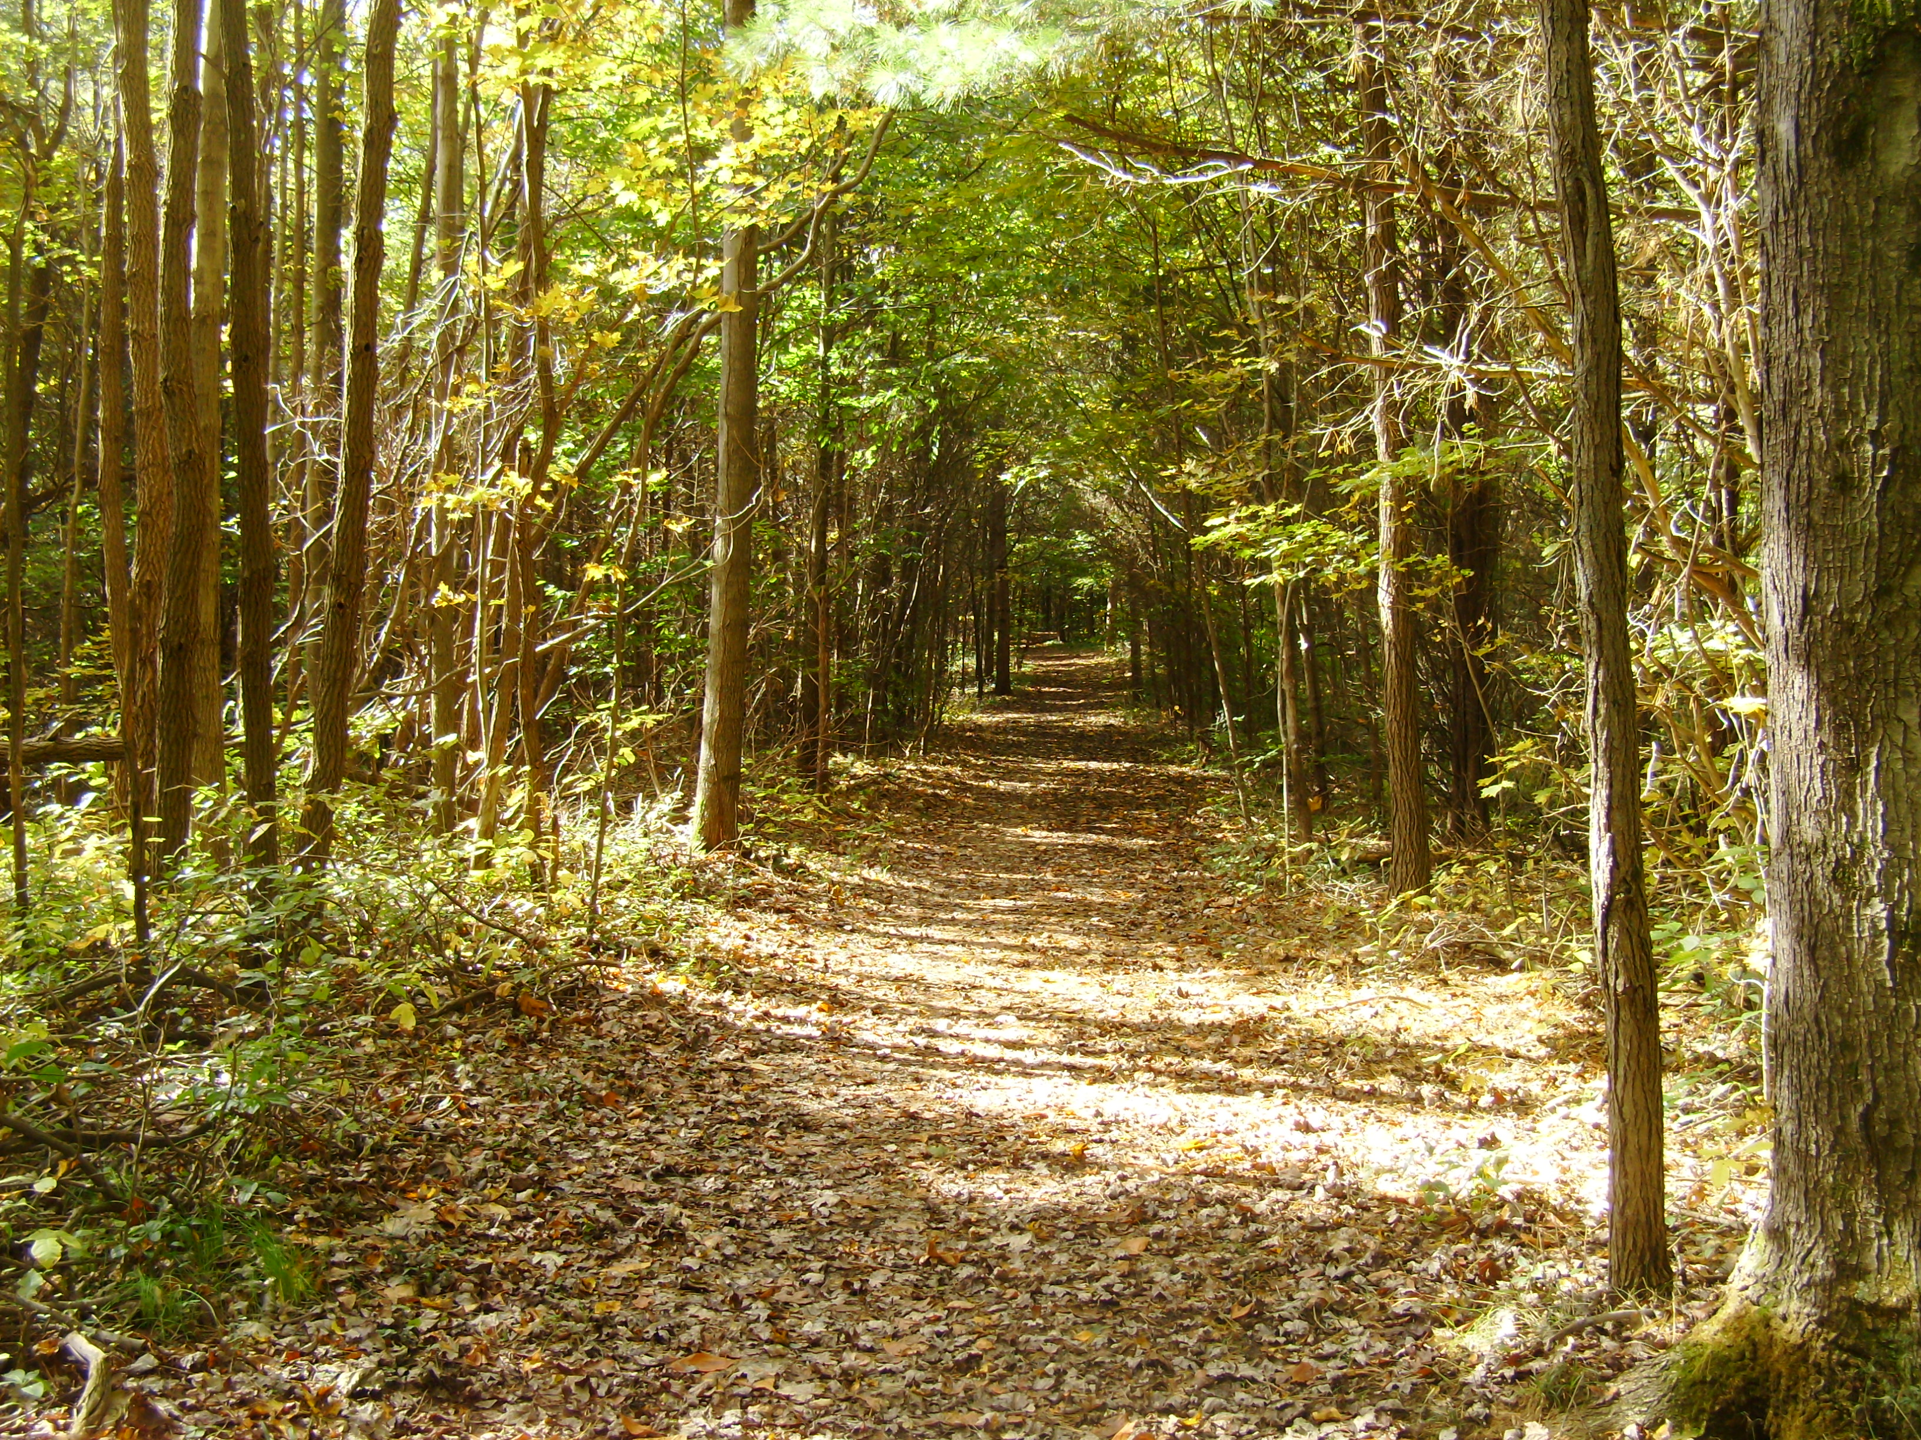


Slide 4
Forest Animals
Let’s see if we can find animals that live…
On the ground
In the trees
Under the water

Slide 5
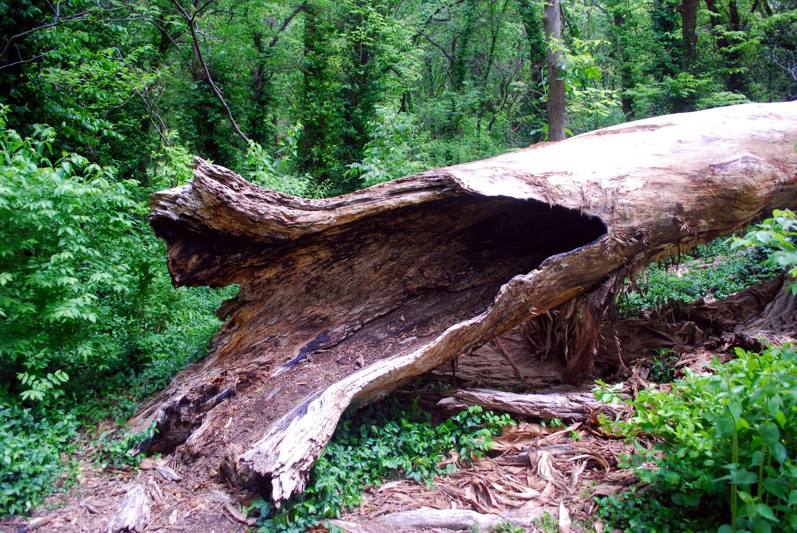

Slide 6
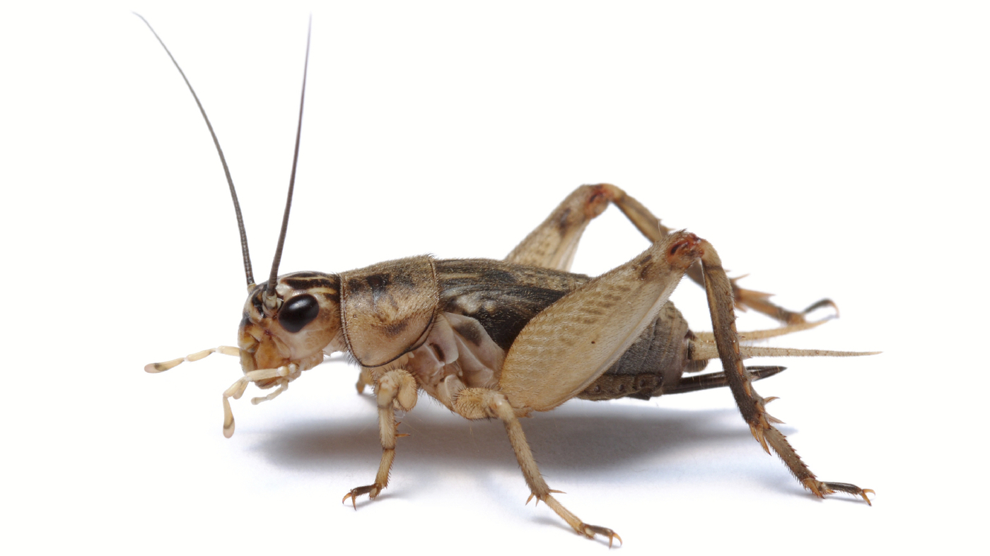
Cricket
Insect
Lives in dark/damp places on the ground.
Eats smaller insects and plants.
Uses its antennae to find food, feels its surroundings, and avoid danger.

Slide 7
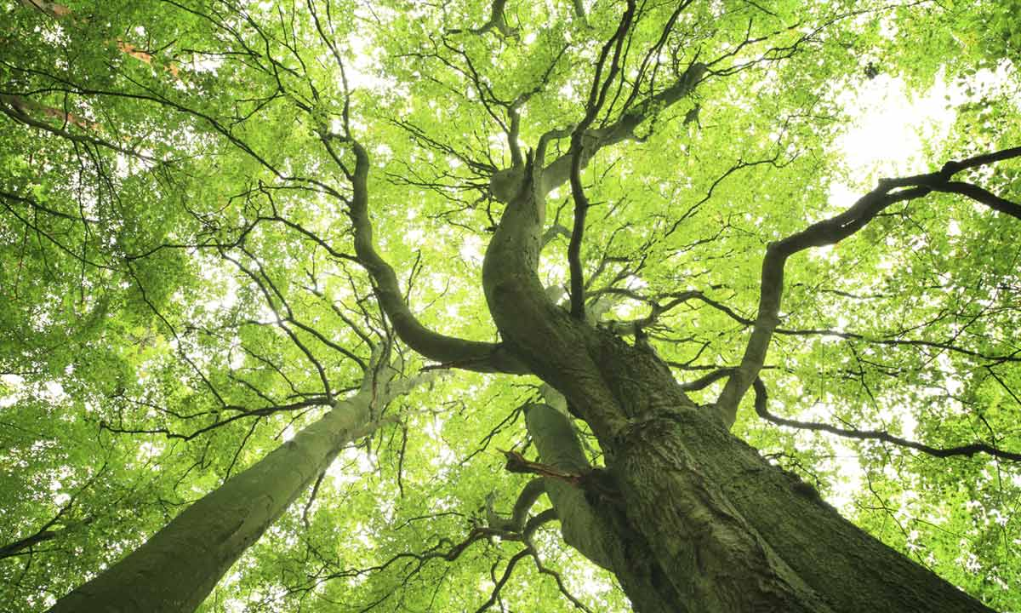

Slide 8
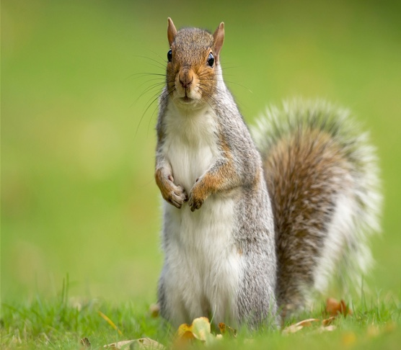
Squirrel
Mammal
Lives in nests built in trees.
Eats plants and nuts in the forest.
Uses its whiskers to feel its surroundings, look for food, and avoid danger.

Slide 9
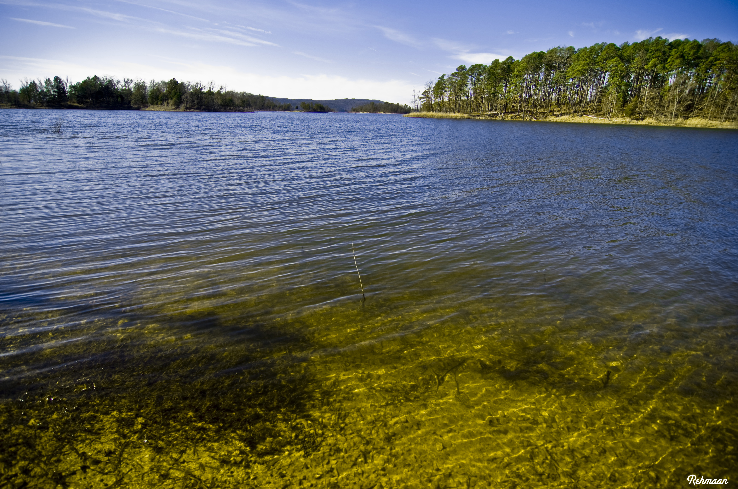

Slide 10
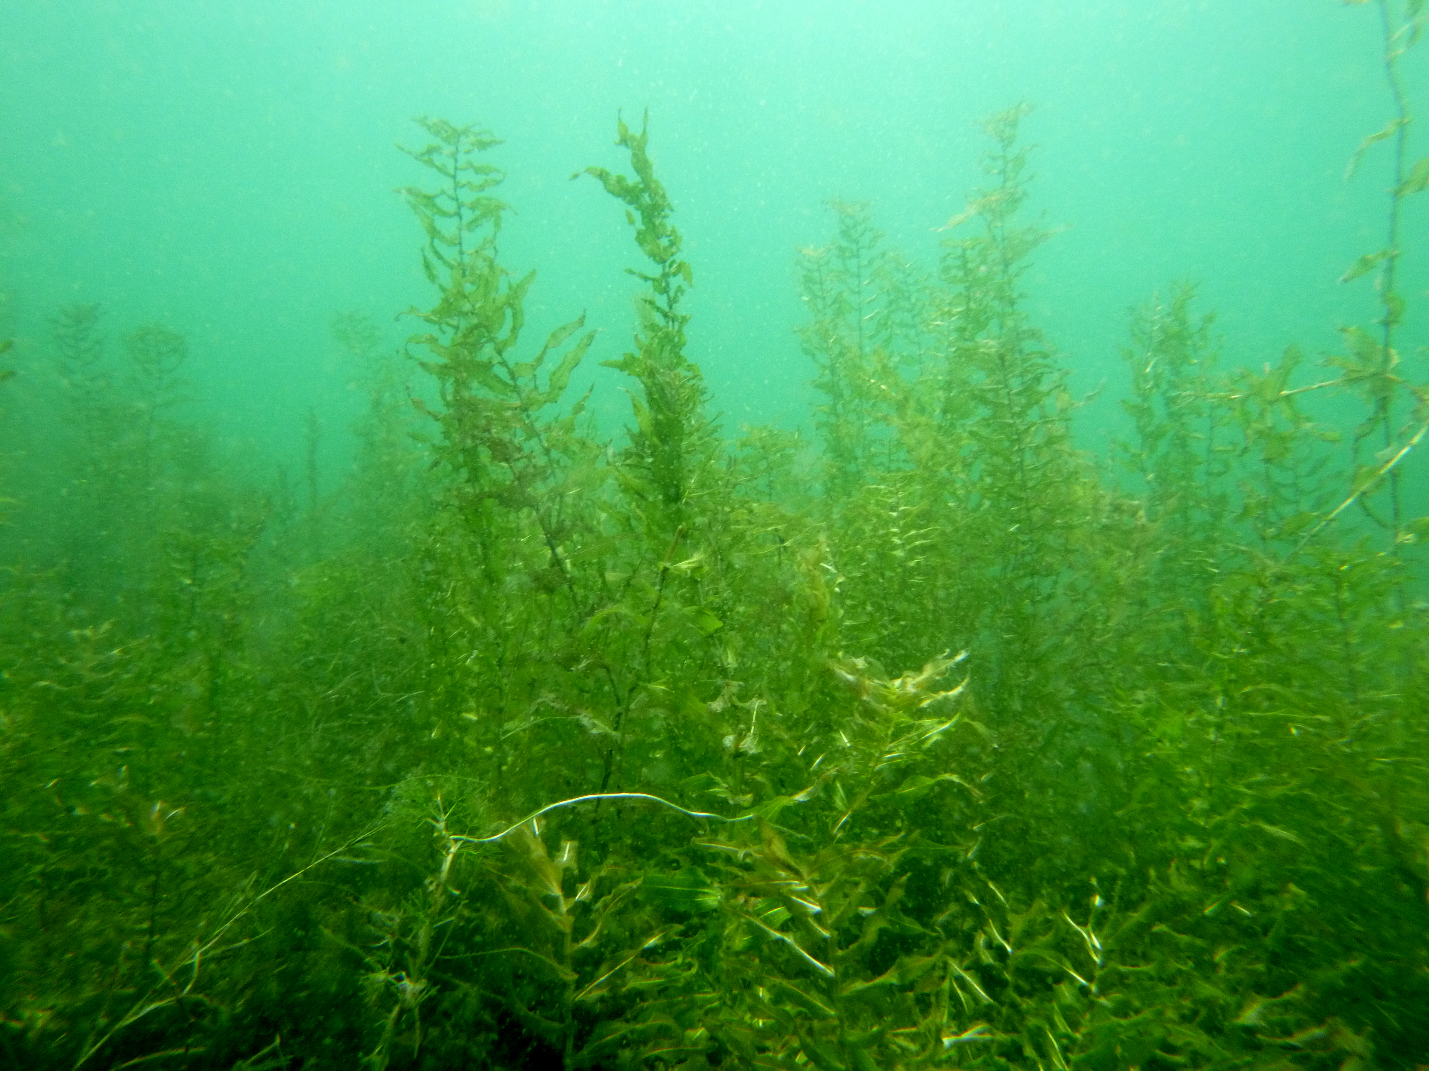

Slide 11
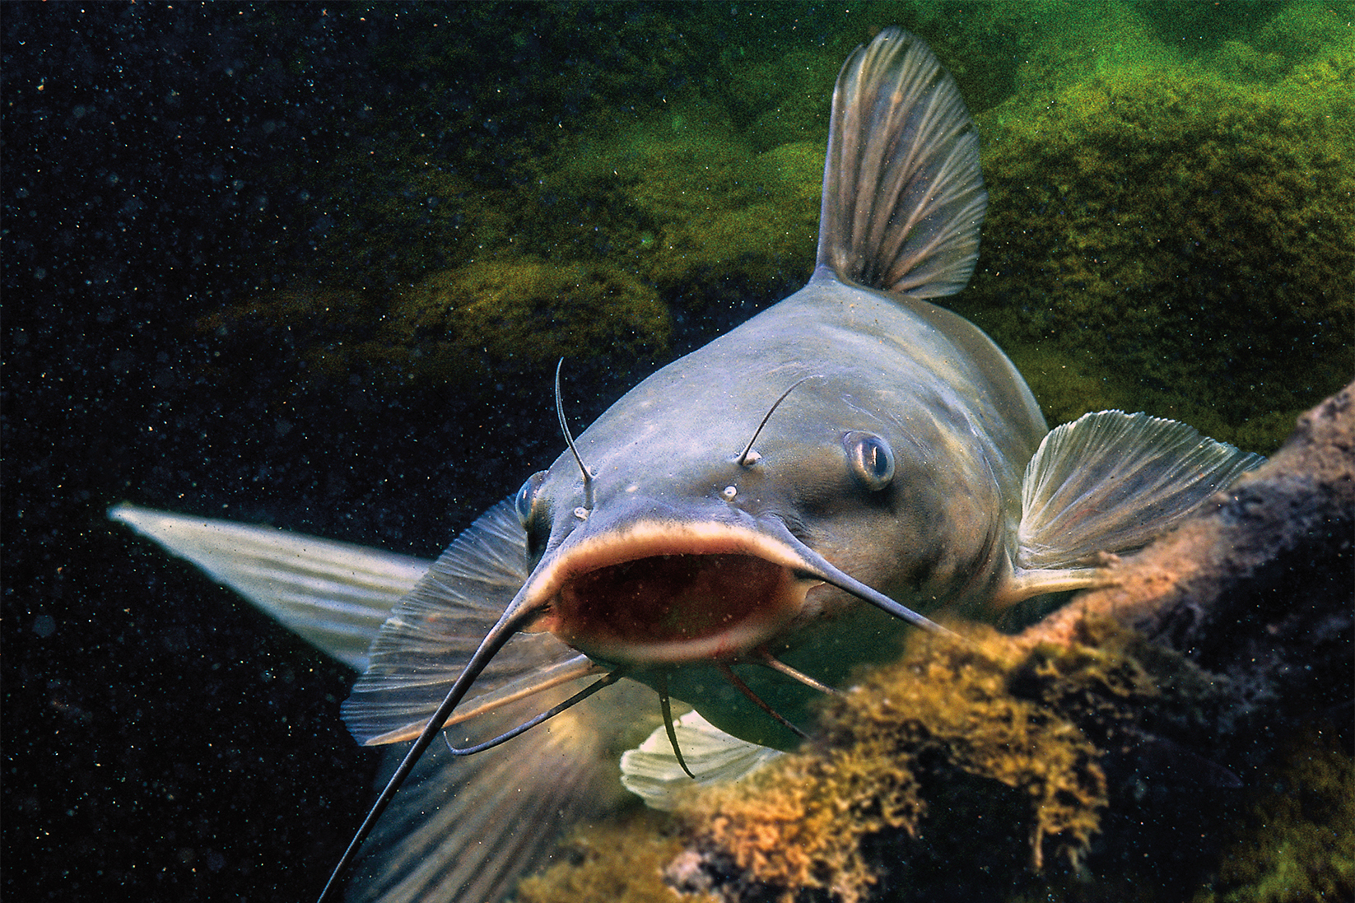
Catfish
Fish
Lives at the bottom of lakes.
Eats plants, insects, and algae.
Uses its whiskers to find food, feel its surroundings, and avoid danger.

Slide 12
Questions
Can you think of any other animals that have whiskers or antennae?
What other reasons do you think animals use their antennae or whiskers for?

Slide 13
What We Learned
Animals use their whiskers/antennae to find food and water.
Animals use their whiskers/antennae to feel their environment.
Animals use their whiskers/antennae to avoid danger and predators.

Slide 14
Sources
"Crickets Chirping" (2008, August 31). Retrieved October 21, 2017, from https://www.youtube.com/watch?time_continue=30&v=CQFEY9RIRJA
"Catfish Opens Mouth" (2015, September 09). Retrieved October 21, 2017, from https://www.youtube.com/watch?v=e1zKAtvdA8k
"Cute Squirrel Jumping" (2013, June 24). Retrieved October 21, 2017, from https://www.youtube.com/watch?v=LA0m0CAdHDQ
Koenig, M. (n.d.). SoundBible.com. Retrieved October 21, 2017, from http://soundbible.com/

